Slide 1
Predicting the improvement of accidents in Bengaluru(India)
Applied Data Science Capstone

Slide 2
Introduction
Background
Bangalore, officially known as Bengaluru, is the capital city of the Indian state of Karnataka. It has a population of over ten million, making it a megacity and the third most populous city and fifth most populous urban agglomeration in India. It is located in southern India on the Deccan Plateau at an elevation of over 900 m (3,000 ft) above sea level, which is the highest among India's major cities. Cars were involved in the highest number of road accidents in Bengaluru records show. Cars, taxis and jeeps were part of 1,473 (32%) of the 4,611 accidents reported in the city in 2018. They were followed by two-wheelers (1,337 cases), Tempo Travellers (482), trucks (392) and buses (360).

Slide 3
Question
Audience
Which areas of the city Bengaluru needs improvement in traffic rules abiding?
Authority of traffic rules in bengaluru can process measures to take prevent accidents in the most accident prone areas.

Slide 4
Data
The dataset for accidents in Bengaluru (2018) is available on kaggle:
https://www.kaggle.com/akshay3dixit/bangalore-accident-data-2018/version/1#
The dataset contains a csv file with attributes:
1.)Latitude
2.)Longitude
3.)Date
4.)Address
5.)Time
To describe each accident.

Slide 5
Methodology
In this project i aim on detecting areas of Bengaluru that have high accident density.We will limit our analysis to just around city center.
In first step we have collected the required data: accident coordinates,address,date,time.
Second step in our analysis will be visualizing accidents in different ways.Using distribution graph,correlation graph,scatter plot.
In the third step our analysis will be calculation and exploration of accident density across different areas of Bengaluru - we will use clustering to identify areas with high accident density.

Slide 6
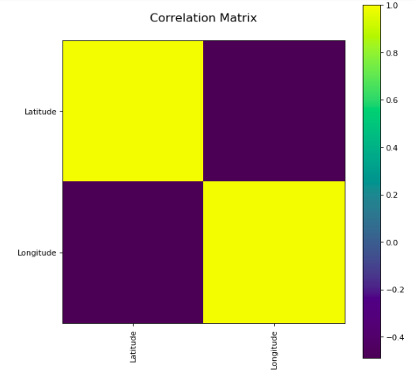
Analysis
Correlation Matrix

Slide 7
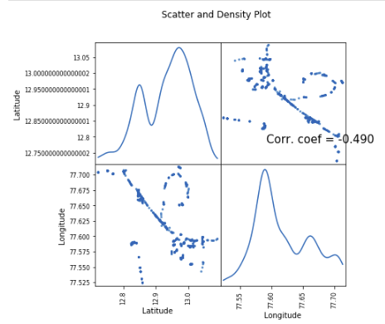
Scatter Plot

Slide 8
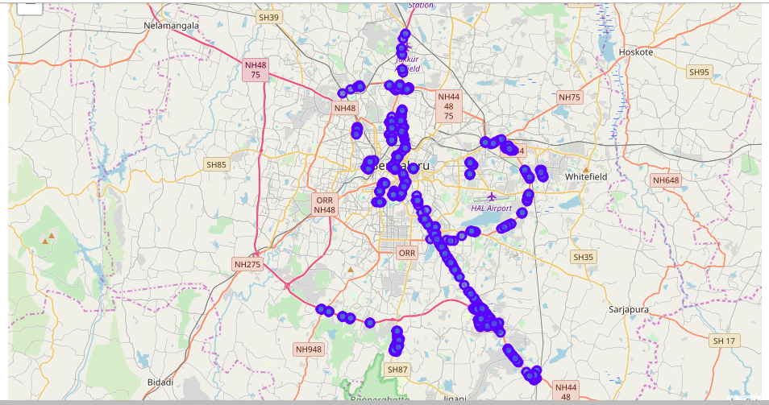
Accidents plotted on a map

Slide 9
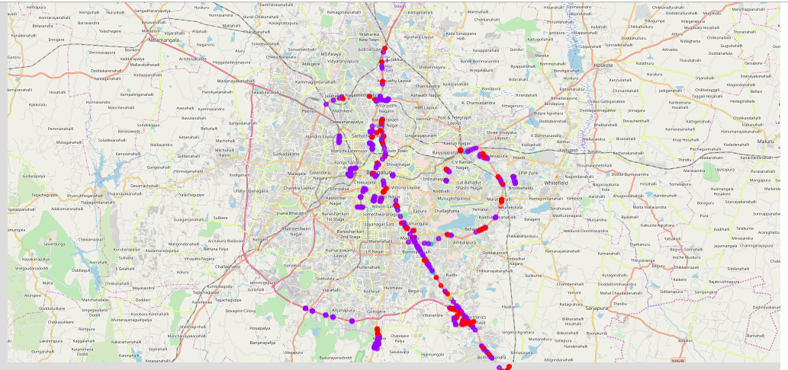
Clustering

Slide 10
Results and Discussion
Analysis shows that a great number of accidents took place in Bengaluru in the year of 2018,there are few areas with a lot of accidents. Highest concentration of accidents was detected in north-west areas of Bengaluru.
Result of all this is 2 zones containing largest number of accidents based on addresses. This, of course, does not imply that those zones are only accident prone areas! Purpose of this analysis was to only provide info on areas with high accident density.Many measures can taken into account for authorities of traffic control to emphasize more safety measure in these accident prone areas.

Slide 11
Conclusion
Purpose of this project was to identify areas prone to road accidents in Bengaluru. By analyzing the areas of accidents and their intensity using different visualizations we can conclude that life is precious for these small mistakes of road accidents and proper analysis like a bit shown can be used to improve these unfortunate events.
Final decision on safety measures for road accidents in these particular areas can taken be taken by the government and traffic control authorities.

